Slide 1

Social Mobility and Education
Date Science in Techno-Socio-Economic Systems
19. May 2025

Slide 2





Motivation
Education
Family
REligion
Influence
Global
Years of studies
Household assests available
Highest education
Education Father
Education Mother
Number of siblings
Christian, Muslim, Hindu, etc.
Different Caste
Education compared to other Attributes
Relevance
Intercontinental
Cross-country differences

Slide 3
Open Questions
Education
Family
Does education tell us anything about current / future income?
Does the environment in which a person is growing up tell us something about current / future income?
Religion
Influence
Is the prediction biased on the religion or culture one has.
If measurable, how much influence do different kinds of attributes (features) have on the predictions?
Global
General
Are there cross-country differences in mobility patterns?
How to find these correlations?
Notes:
During our studies a lot of interesting questions came up.
The question we asked ourselfs was the general one: How to find these correlations?

Slide 4
How to find these correlations?
Neural Network
Excels at learning highly complex, non-linear patterns
Random Forest
Captures complex, non-linear relationships
Multiple Linear Regression
Quickly interprets linear relationships

Slide 5

Country Analysis

Slide 6
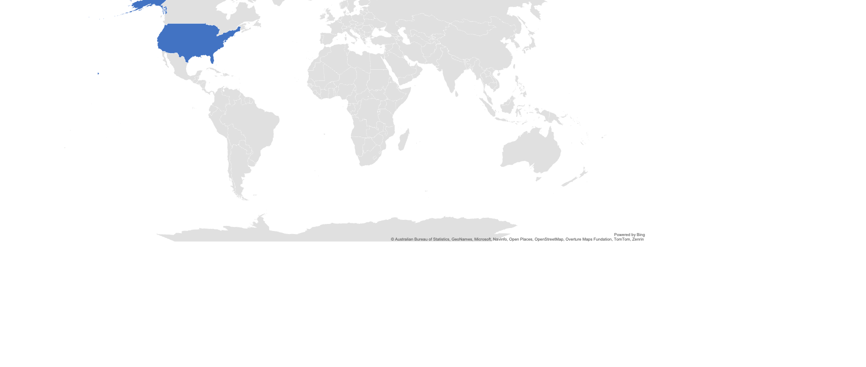
Country Analysis
USA
Notes:
Talk about the American Dream
Resoning why America

Slide 7

Country Analysis
USA
Germany
Notes:
Reasoning why Germany:
Germany is economically one of the leading countries of europe

Slide 8
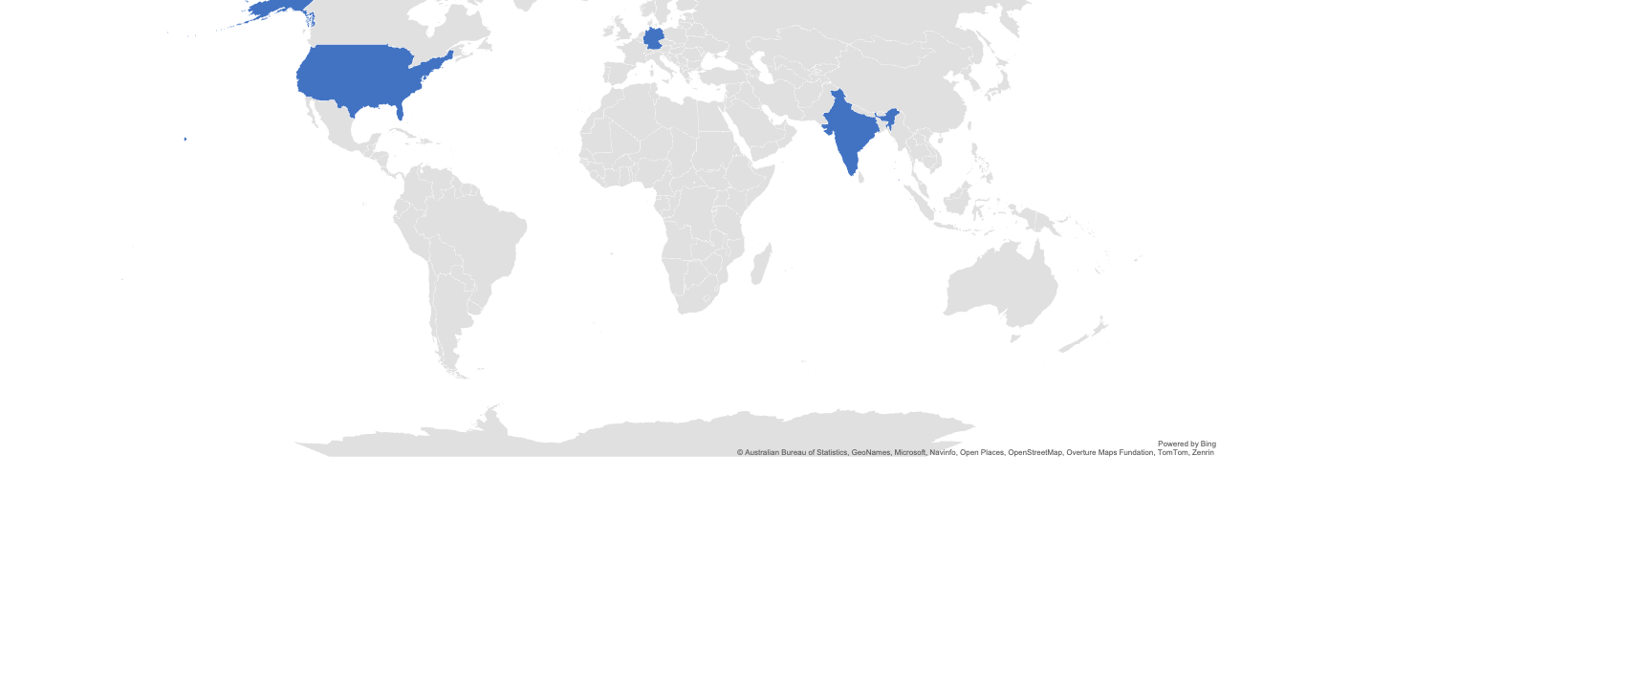
Country Analysis
India
USA
Germany
Notes:
India is the largest democraty

Slide 9
Hypothesis
The combination of education level and environmental quality metrics predicts income mobility better than either factor alone.
Higher levels of individual education are associated with increased upward social mobility, as measured by a weaker correlation between other features such as parental income, education, …

Slide 10
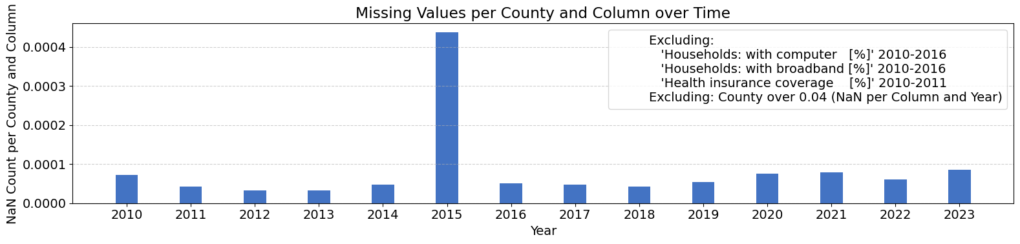
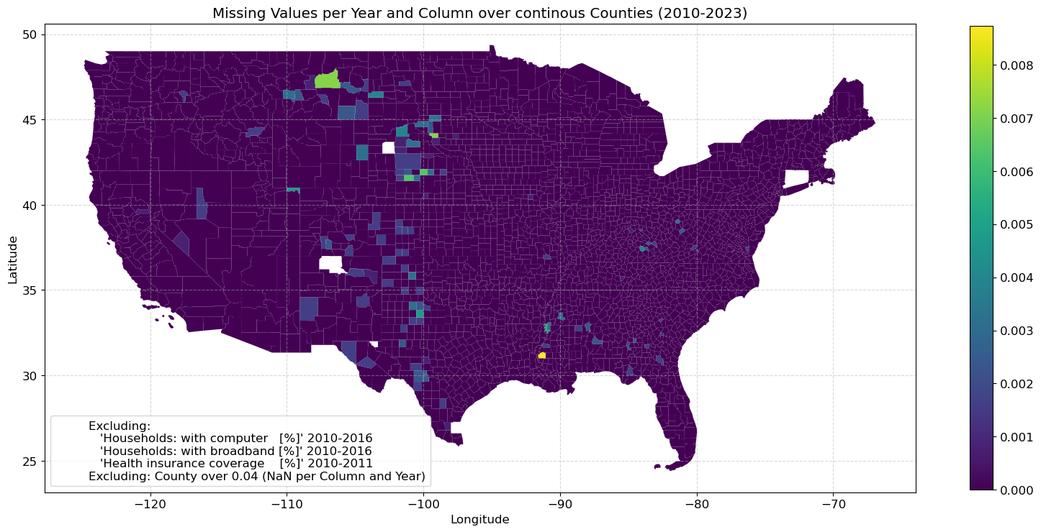
Data & Model
Data
U.S. Census Bureau: America Community Survey: 5-Year Estimates Data Profiles
U.S. Census Bureau: Tiger Shapefile
Tables: 14 * 5 = 70
Timeframe: 2010-2023
Geographic Scope: Continious Mainland U.S. Counties
Model
LSTM-based Model
High Total Feature Dropout
73 Features
3 Year Context Window

Slide 11
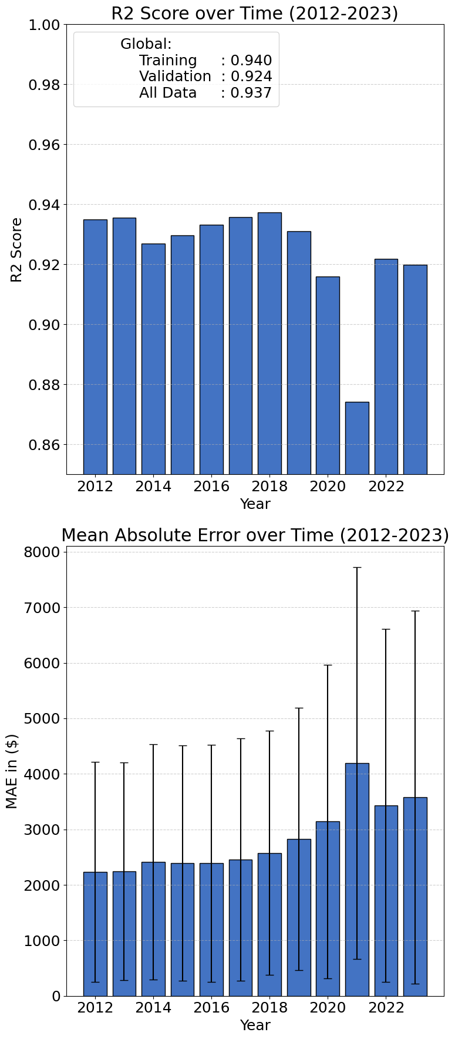
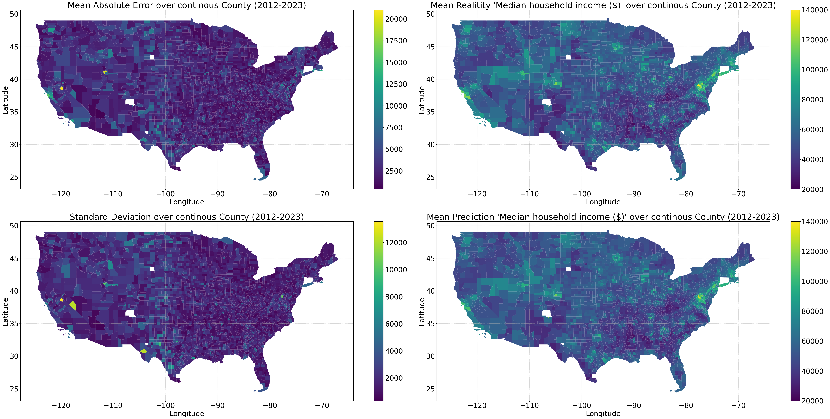
Model Quality
Notes:
R2: Training: 0.940 ,Validation: 0.924, All: 0.937

Slide 12
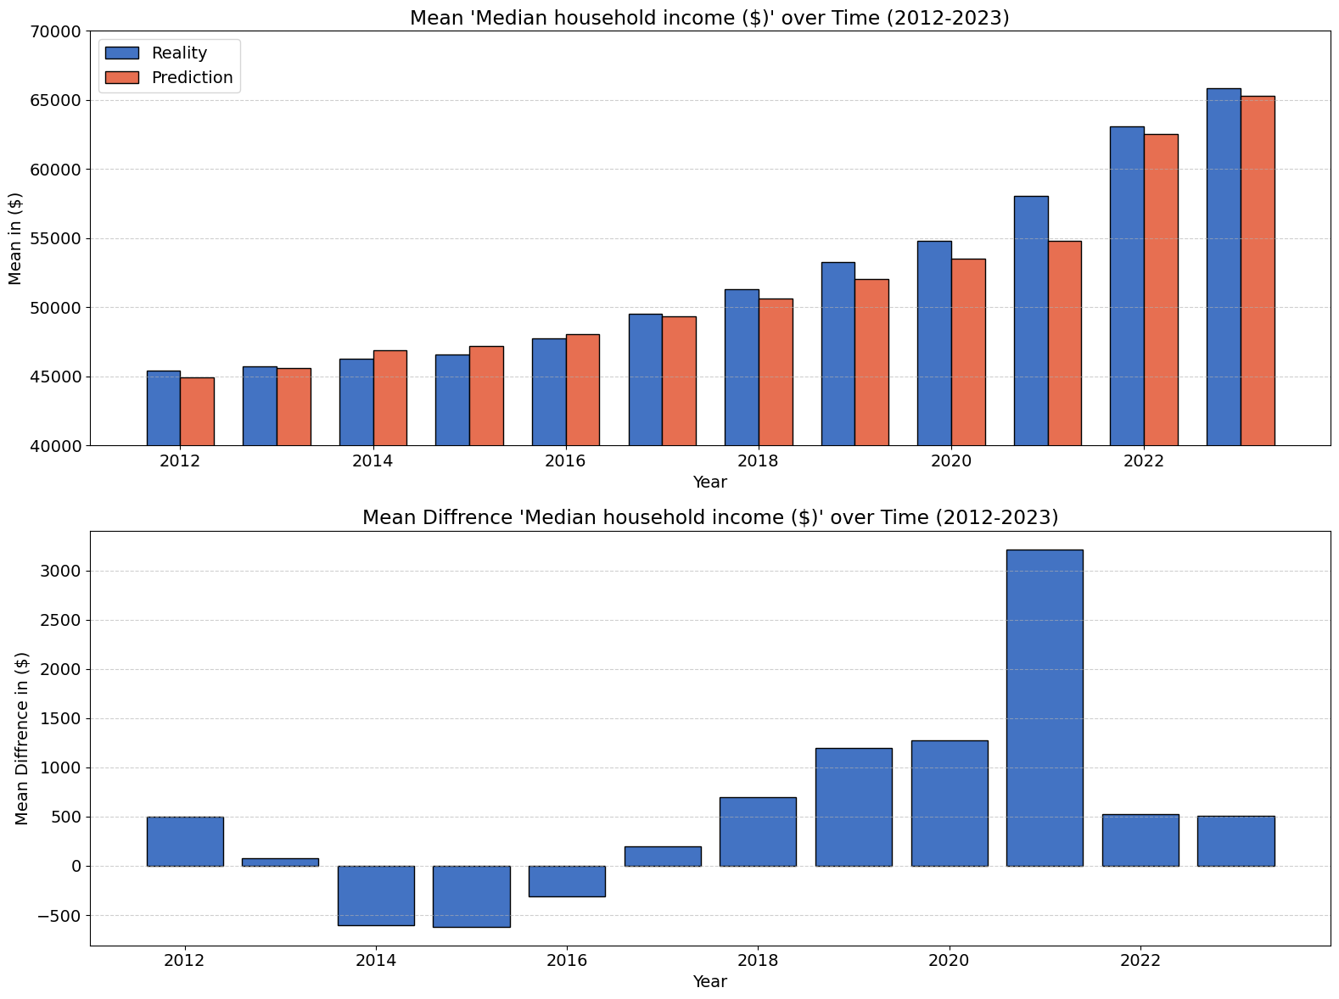
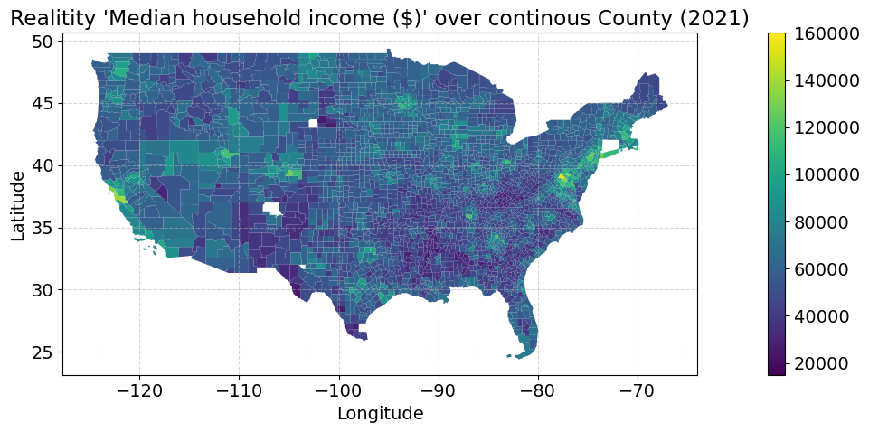

Prediction

Slide 13
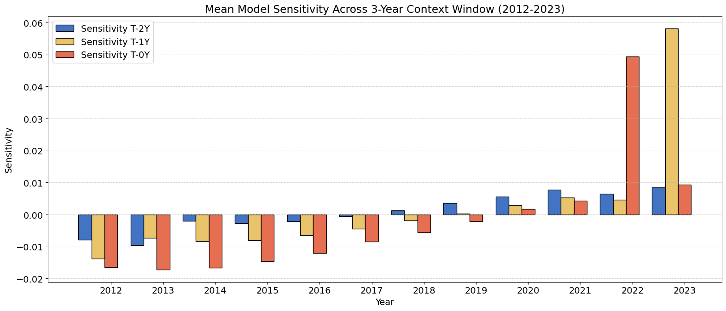
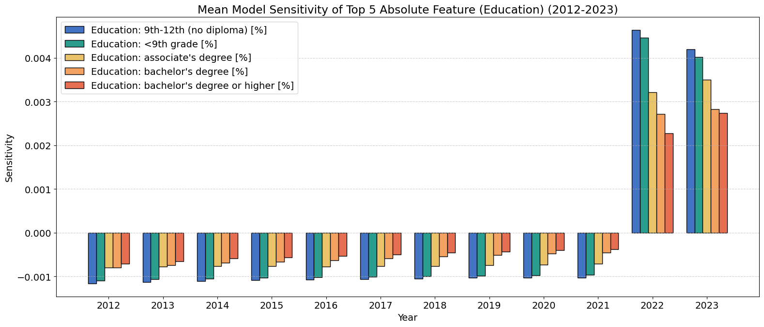
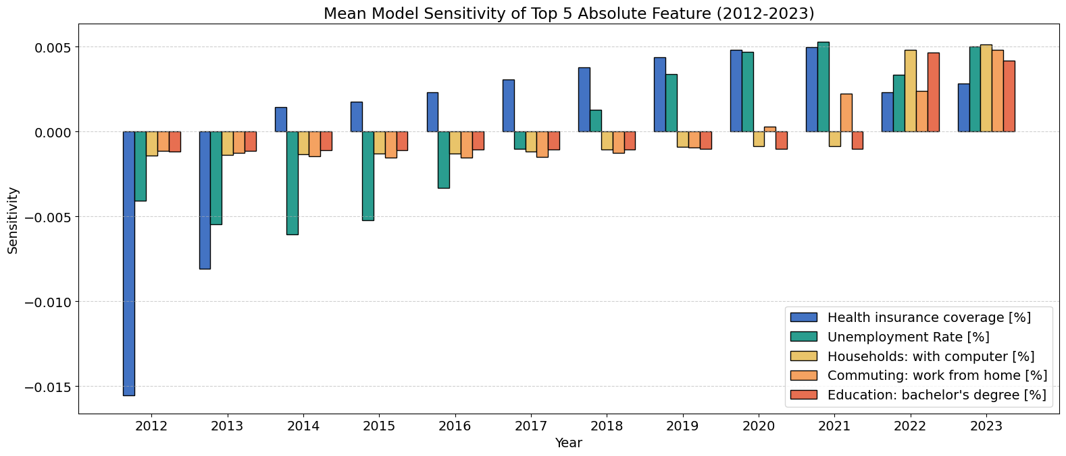
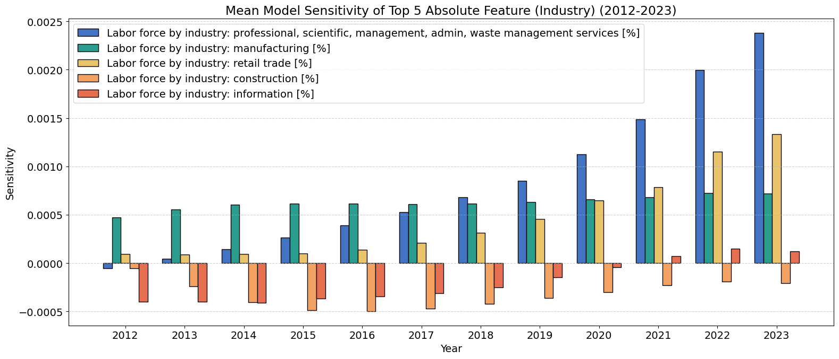
Sensitivity Analysis
Notes:
+ Summary

Slide 14
Germany - Resources
Dataset
Methods
Aggregated data: no individuals information
County level: 390 / 476 Landeskreise
Time span: 10 years
Total samples: 3900
Models
Random Forest (RF) classification of income classes
Multiple linear regression (MLR)
Train (80%) and Test (20 %) splits:
Split randomly with 30 different seeds
Mean and standard deviation estimation
Feature Importance:
Random forest: Permutation feature importance (rank)
MLR: Fitted coefficients
limitation due to data quality
_{Data and shapefile sources:}
© Statistisches Bundesamt (Destatis), GENESIS-Online, https://www.regionalstatistik.de/genesis/online, accessed on: [2025]
© BKG (2025) dl-de/by-2-0, Datenquellen: https://sgx.geodatenzentrum.de/web_public/gdz/datenquellen/Datenquellen_vg_nuts.pdf

Slide 15
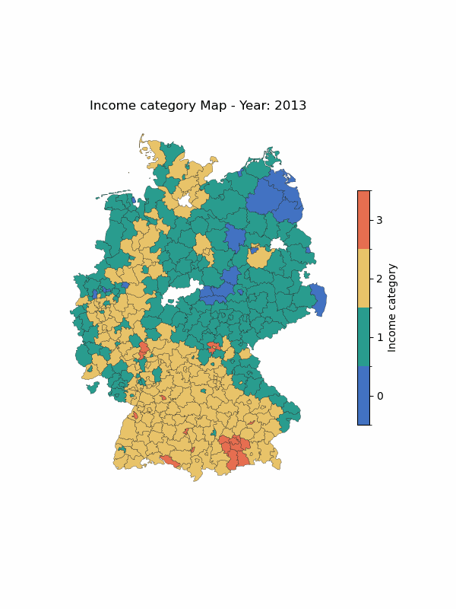
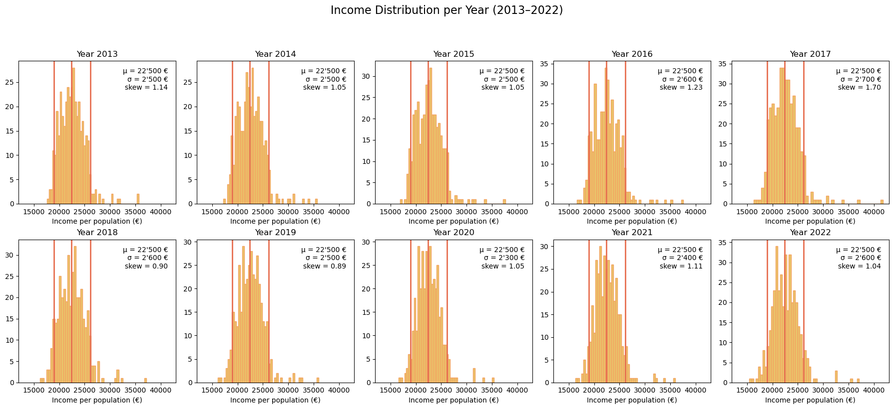
Income Categories
Category 0: < 5th percentile
Category 1: 5th - 50th percentile
Category 2: 50th - 95th percentile
Category 3: >95th percentile

Slide 16
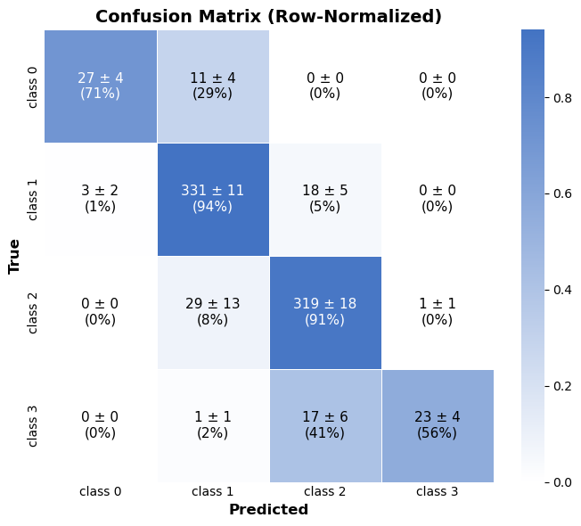
Classification
Random Forest
Overfitting
Mean test accuracy: 0.897 ± 0.018
Mean train accuracy: 1 ± 0

Slide 17
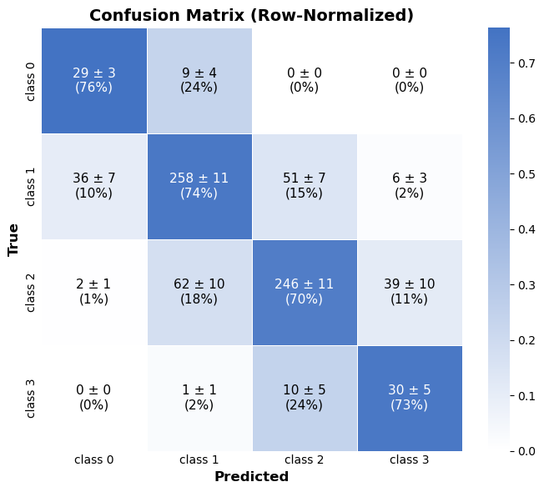
Classification
Random Forest
Preventing overfitting
Mean test accuracy: 0.723 ± 0.019
Mean train accuracy: 0.780 ± 0.008

Slide 18
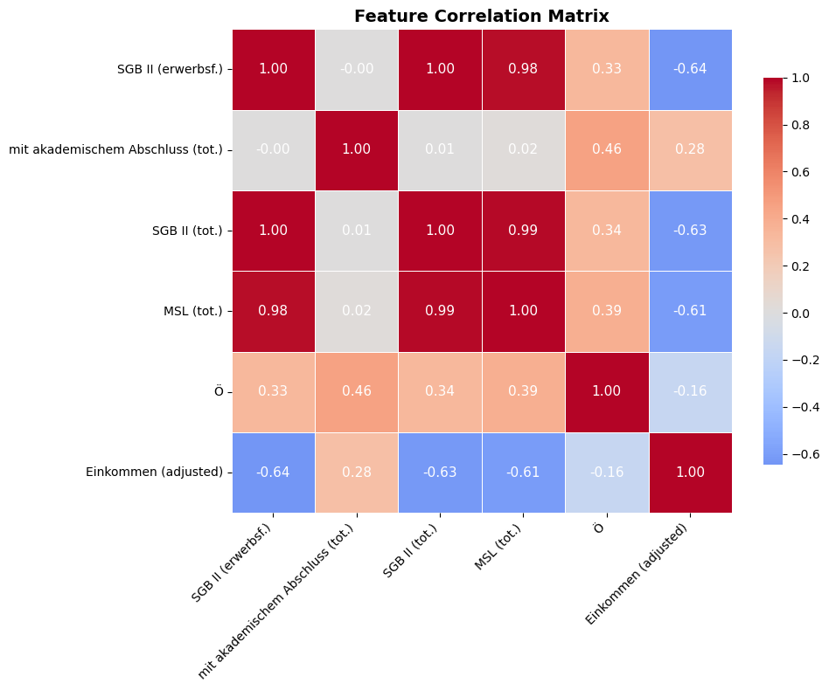
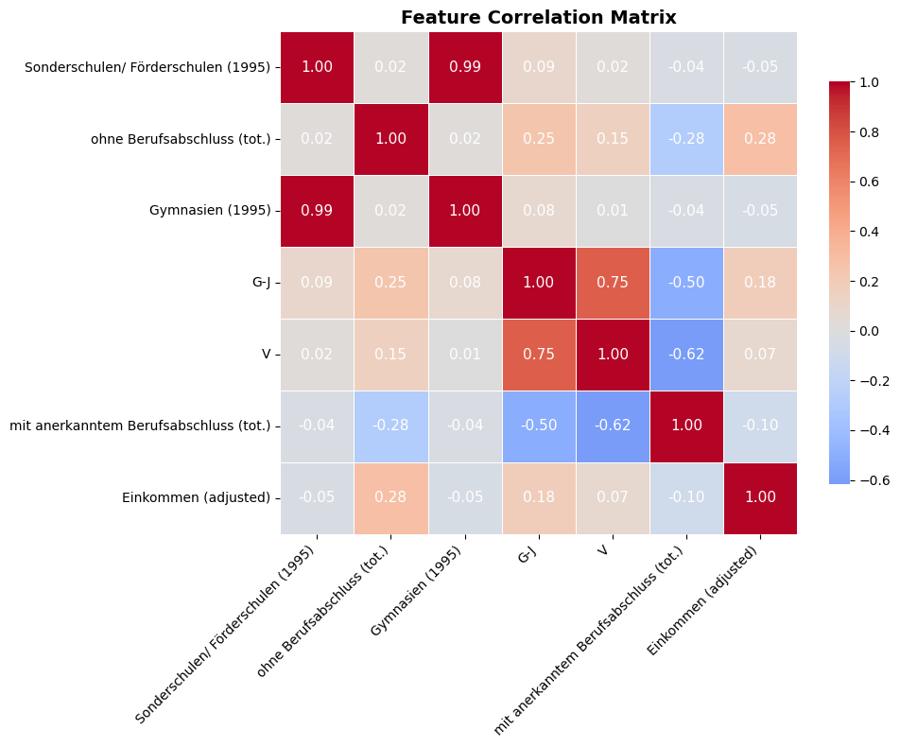
Classification
Feature Importance
Overfitted model
Not overfitted model
Top 5 Features by average rank | Rank
Standard benefit (employable) | 1.3 ± 0.7
Employed residents with academic degree (tot.) | 2.6 ± 1.0
Total standard benefit | 3.4 ± 1.8
Minimum income support benefits (tot.) | 5.2 ± 2.5
Employed persons in Public & Social Services | 5.9 ± 2.9
Top 5 Features by average rank | Rank
Sonderschulen/ Förderschulen (1995) | 2.9 ± 1.5
Employed residents without vocational degree (tot.) | 3.5 ± 3.3
Gymnasien (1995) | 4.4 ± 2.8
Employed persons in Trade & Transport (G-J) | 5.5 ± 4.1
Employed persons in Finance & Real Estate (V) | 6.8 ± 4.5

Slide 19
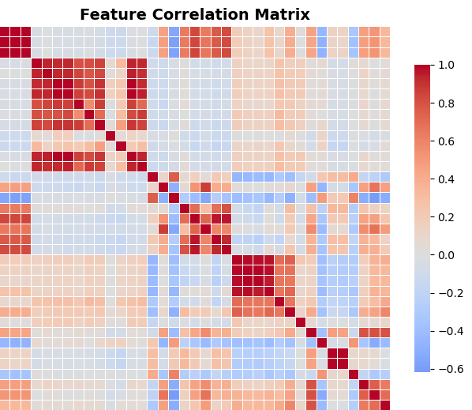
Highly correlated features
Highly correlated features hurt interpretability in MLR

Slide 20
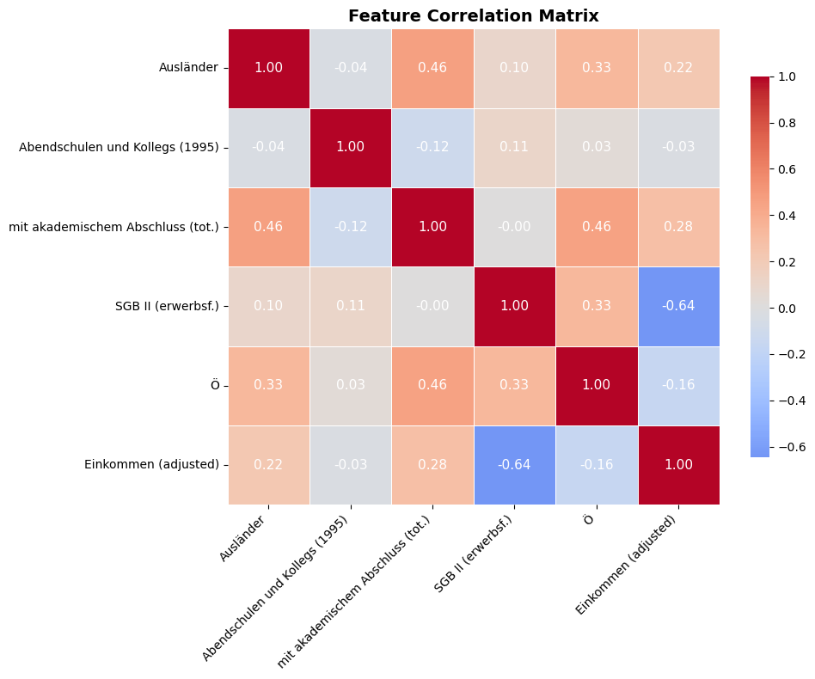
Weakly correlated features
Subset of features with weak to moderate correlation

Slide 21
Regression
Multiple Linear Regression
All features
Subset of features
R² Score: 0.67 ± 0.02
R² Score (train): 0.680 ± 0.005
RMSE: 1460 ± 80 €
R² Score: 0.54 ± 0.02
R² Score (train): 0.547 ± 0.006
RMSE: 1730 ± 90 €

Slide 22
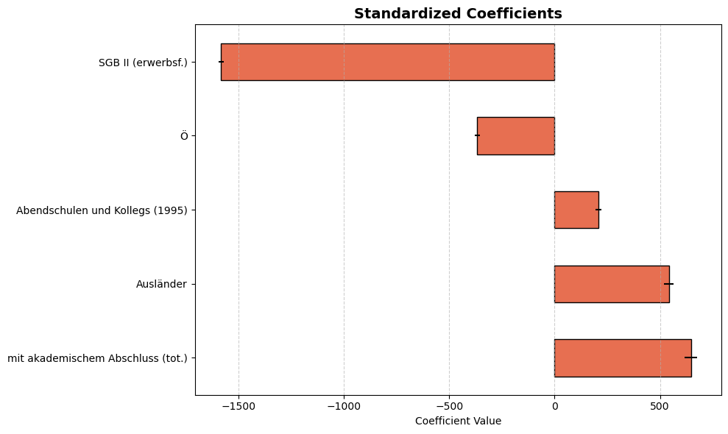
Regression
Subset of features
R² Score: 0.54 ± 0.02
R² Score (train): 0.547 ± 0.006
RMSE: 1730 ± 90 €

Slide 23
Conclusion
Education and social benefits are good predictors of income in regional aggregate data.
Number of schools per capita build in 1995 become good predictors for generalizable classifiers.
We could use a small ANN to allow non-linearities

Slide 24

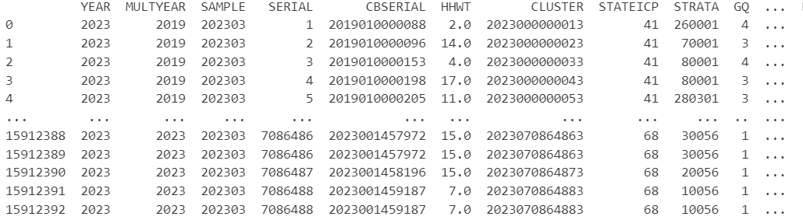
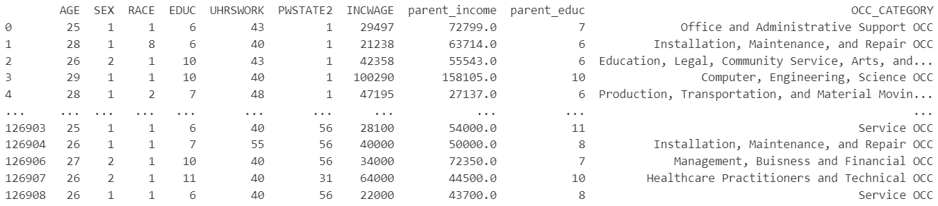
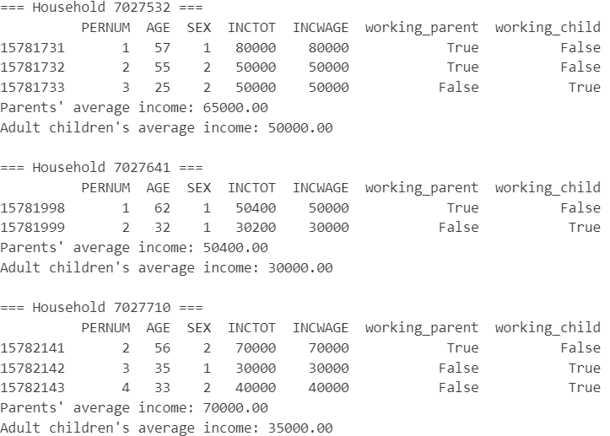
Features:
AGE: Age in years
SEX: Biological sex
RACE: Race codes
EDUC: Education codes
UHRSWORK: Usual hours worked per week
PWSTATE2: Place of work: state
INCWAGE: Income from wage
OCC_CATEGORY: Occupation code
Total number of individuals: 15912393
Data from 2019-2023
Sort by households
and identify
working child and working parent
Total number of individuals: 118215
Working child:
EMPSTAT (employment status = 1 or 2 (self-employed))
AGE: 25-35
INCWAGE (Income from wage): 15000-300000
UHRSWORK: >=35
Working child:
EMPSTAT (employment status = 1 or 2 (self-employed))
INCTOT (Total income): 15000-300000
UHRSWORK: >=35

Slide 25
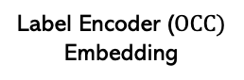
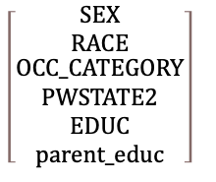
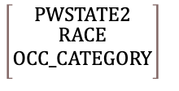
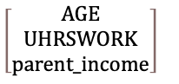

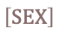
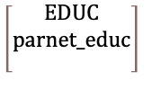
Model Architecture
Ordinal
$$\left[\begin{matrix}EDUC \\ parnet_educ \\ \end{matrix}\right]$$
Categorical
features
One-hot-encoder
Input layer
Input dimension: 50
Hidden layer 1
128 neurons
$$\left[\begin{matrix}SEX \\ RACE \\ \begin{aligned}OCC_CATEGORY \\ PWSTATE2 \\ EDUC \\ parent_educ\end{aligned}\end{matrix}\right]$$
Binary
Hidden layer 2
64 neurons
$$\left[SEX\right]$$
Categorical
Label Encoder ($OCC)$
Embedding
$$\left[\begin{matrix}PWSTATE2 \\ \begin{aligned}RACE \\ OCC_CATEGORY\end{aligned} \\ \end{matrix}\right]$$
Ouptut
INCWAGE
Numerical
features
$$\left[\begin{matrix}AGE \\ UHRSWORK \\ parent_income\end{matrix}\right]$$
Activation function
ReLU()

Slide 26
Model Architecture
Input layer
Input dimension: 50
Hidden layer 1
128 neurons
ML Model
Optimizer Loss Max Epochs Batch sizes: Training/Validation/Test | Adam Mean Squared Error 100 64 80%/10%/10%
Hidden layer 2
64 neurons
Ouptut
INCWAGE
Activation function
ReLU()

Slide 27
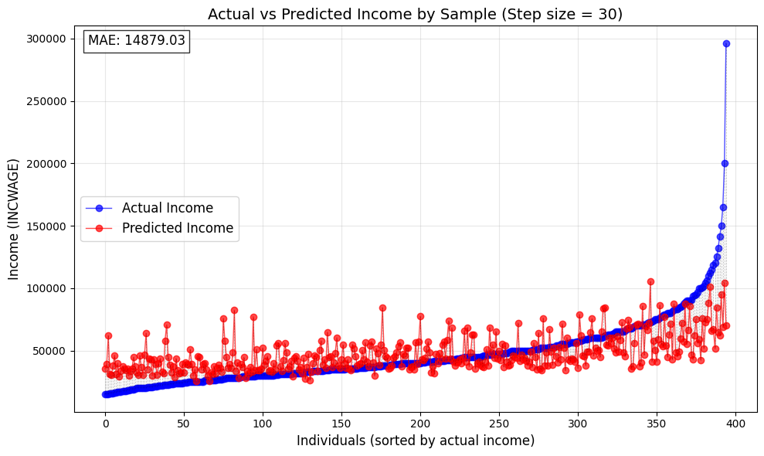
Accuracy
Metric | Loss
MAE RMSE R² Median Absolute Error Mean Absolute Percentage Error | $14985 $21975 0.29 $10684 36.27

Slide 28
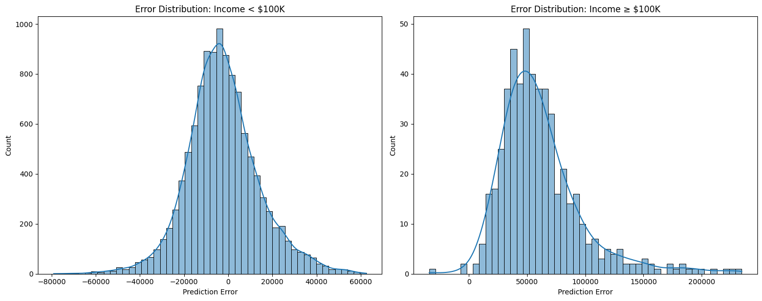
Accuracy

Slide 29
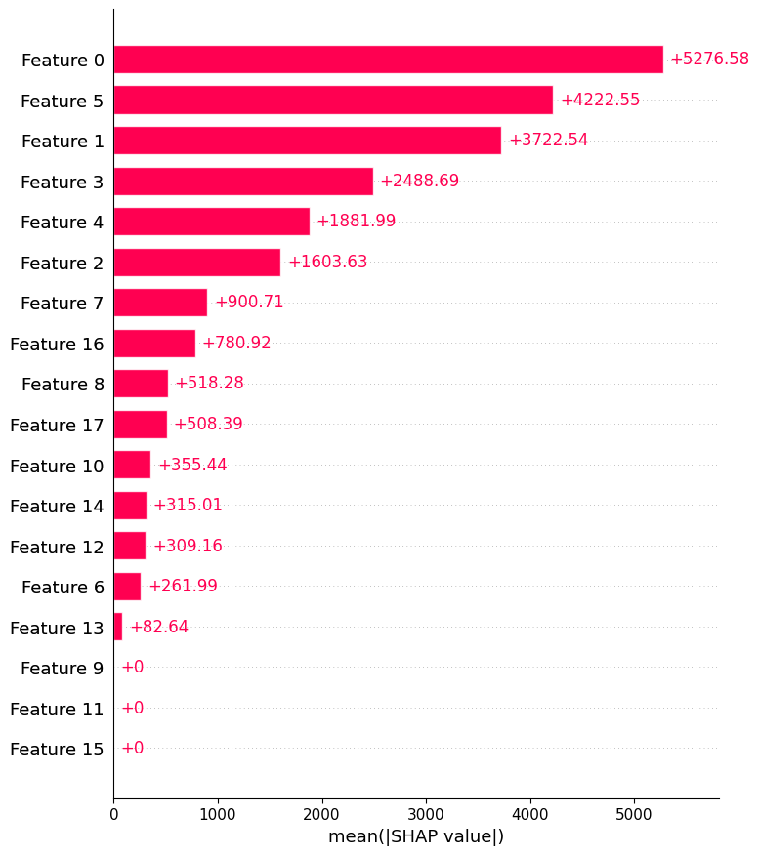
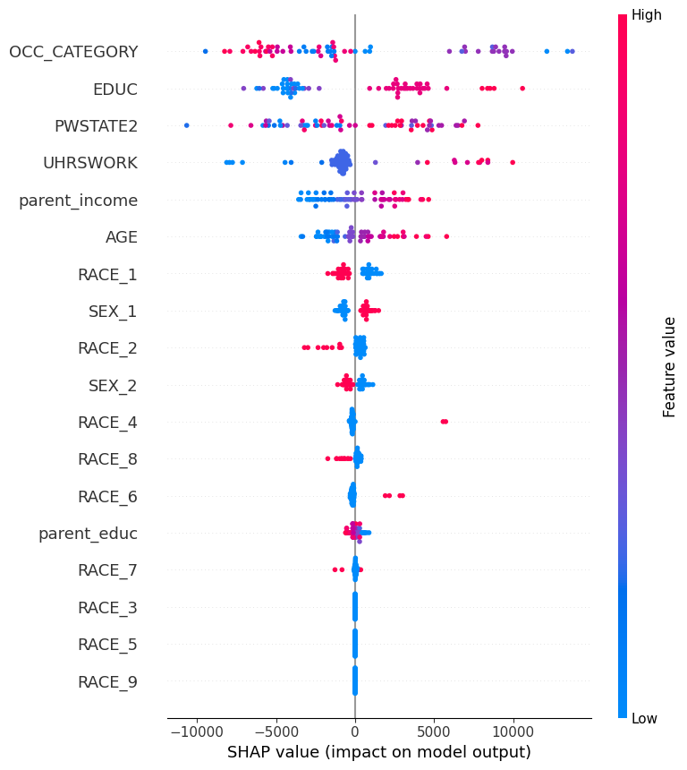
Feature Analysis
RACE = {
"White":1,
"Black":2,
"American Indian": 3,
"Chinese": 4,
"Japanese": 5,
"Other Asian": 6,
"Two major races": 8,
"Three or more major races": 9
}
SEX = {"Male":1,
"Female":2}

Slide 30
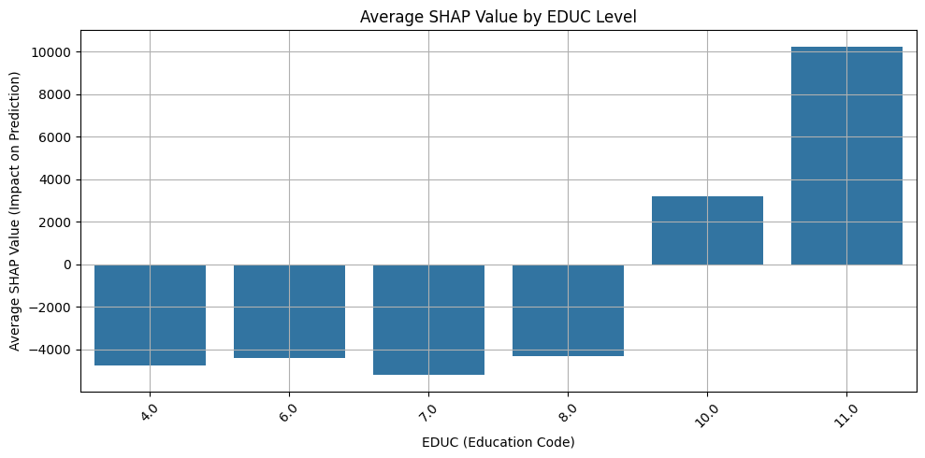
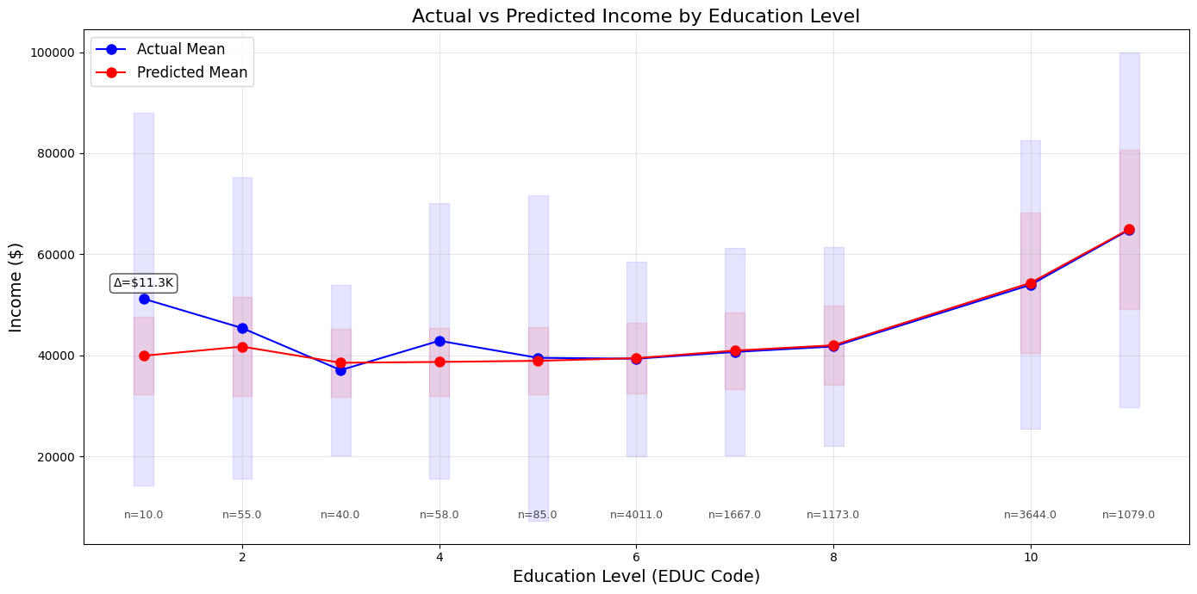
Feature Analysis

Slide 31
Conclusion
Thoughts
Improvements
Education is one of the most important factors indicating strong correlation between education and income
Higher Education leads to higher income
Neural network can make moderately good predictions for income within a certain income range (<100k)
Model struggles to predict incomes higher than 100k (indicating that specific features or factors may be responsible for higher income levels)
Utilize more features (Feature gap mitigation)
Data sparsity --> more Data necessary
Feature engineering (Engineer features which target hidden determinats of high incomes)
Notes:
Temporal information other datasets as IHDS 2 and 3
External data enrichment: incorporating regional variables
New features such as dependency rations, interaction terms (education * caste)

Slide 32
India - Dataset IHDS
Characteristics
Preprocessing
India Human Development Survey
Size: 41’554 housesholds
Variaty: 937 variables
Timespan:
IHDS1: 2004-2005
IHDS2: 2011-2012
IHDS3: ?
Pick the interesting features
Cleaning the data in terms of
Positive Income
Missing values: ‘’ or ‘ ‘
Numeric Data Type
Convert to Tensors and Dictionaries
Notes:
Think about an answer for the question: Why these features?
About Positive income: Some anayses by IHDS staff suggest that these households do not appear as poor on other dimensions as households with low but positive incomes.
Thus to get rid of some noise one can only make an analysis on the households with positive income
Dataset should handle missing values with inserting negative values (for the categorial columns) but sometimes there is no value at all.

Slide 33
Features
Location
Stateid, Distid, Distname
Education
Highest male / female education
At least one literate adult
Family
Number of children in HH
Number of persons in HH
Geographic
Urban
Metro
Religion and Caste
Brahmins, …, Dalits
Muslims, Sikhs, Jains, Christians
Household assests
Computer, Car, HHassets
Notes:
Hhassets scale sums 30 dichotomous items measuring household possessions and housing quality

Slide 34
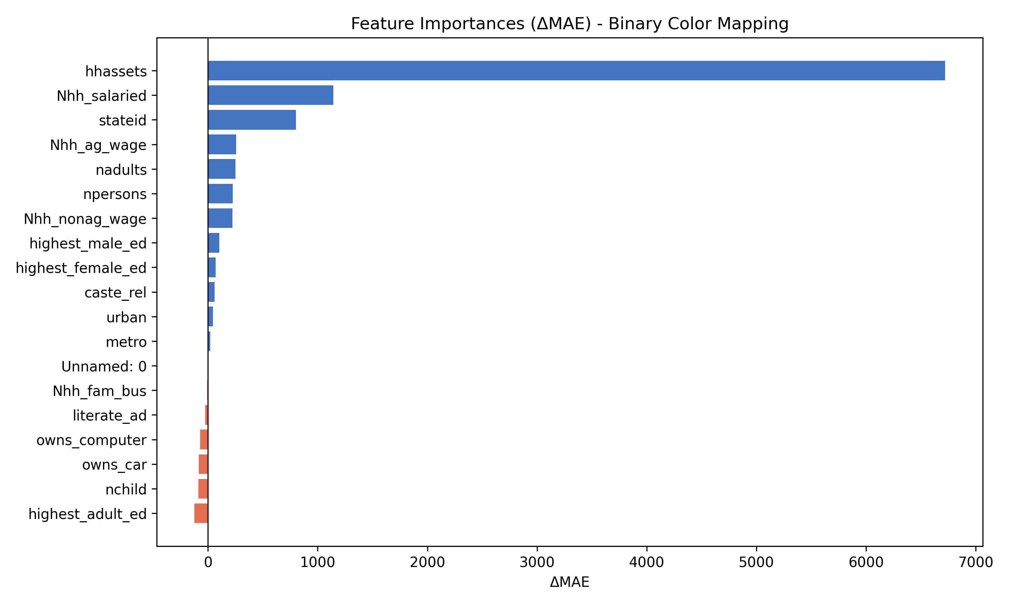
Features
Location
Stateid, Distid, Distname
Education
Highest male / female education
At least one literate adult
Family
Number of children in HH
Number of persons in HH
Geographic
Urban
Metro
Religion and Caste
Brahmins, …, Dalits
Muslims, Sikhs, Jains, Christians
Household assests
Computer, Car, HHassets
Notes:
Hhassets scale sums 30 dichotomous items measuring household possessions and housing quality

Slide 35
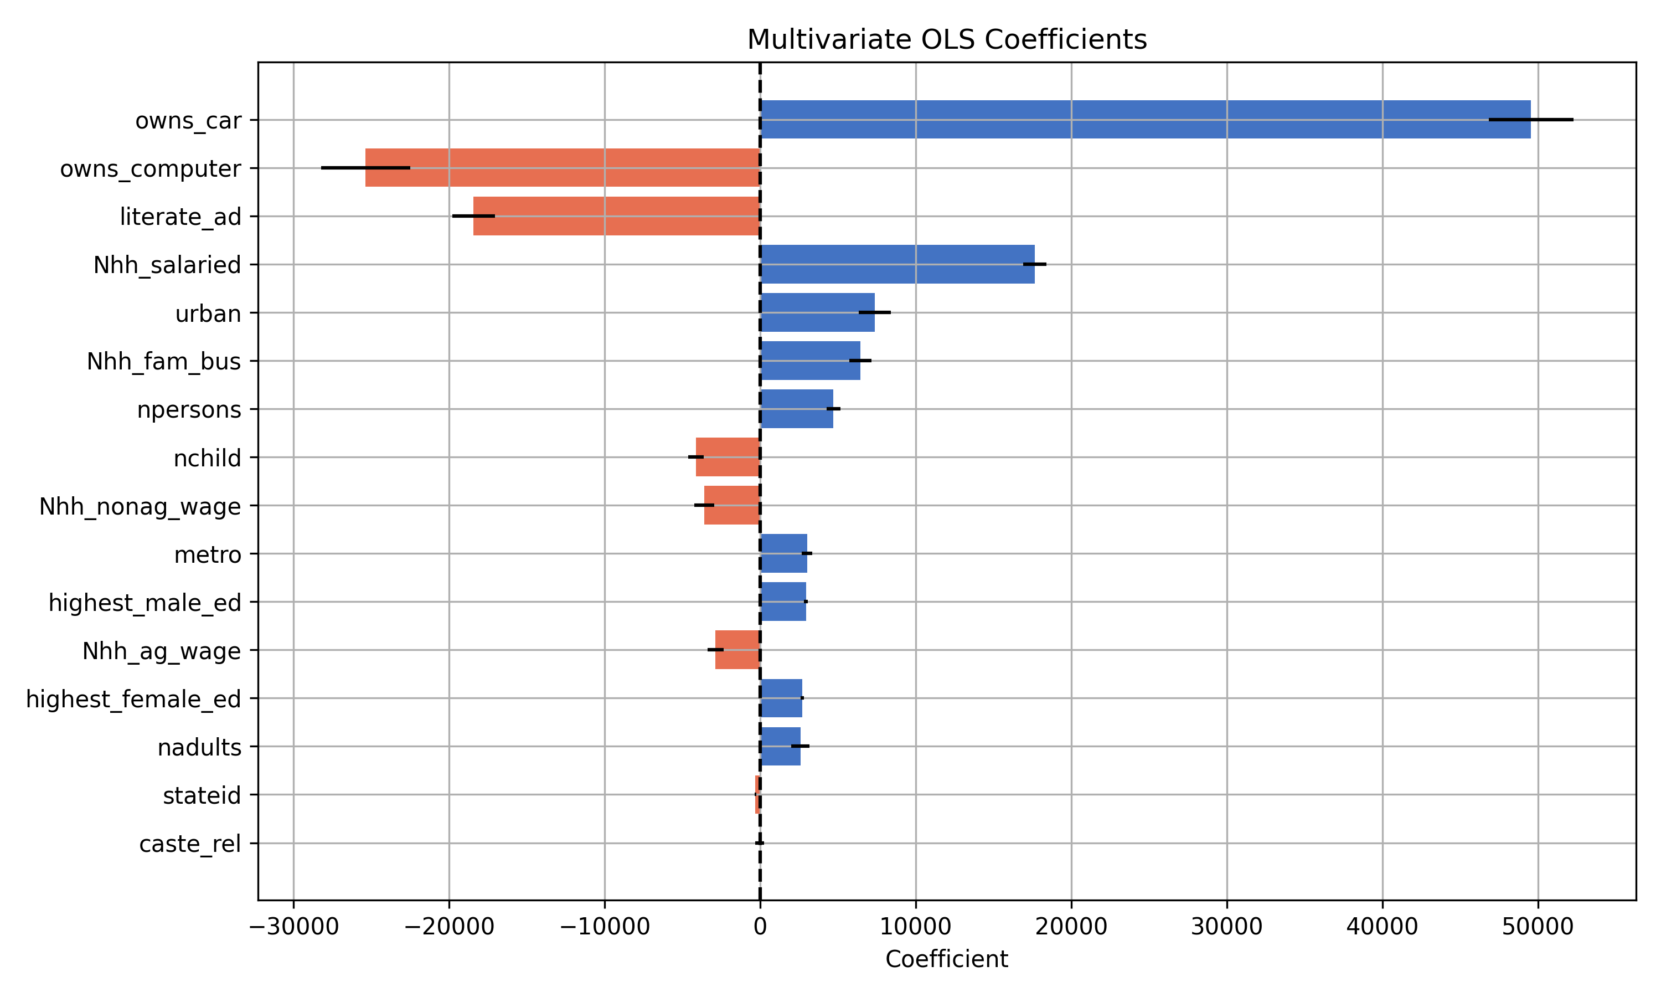
Regression

Slide 36
Regression
Metric | Loss
R2 Score | 0.206
Skewness | 5.6
Kurtosis | 61
High coefficients
Unreasonable coefficients
Notes:
2. Extremely high Kurtosis
High kurtosis > 3
Indicates freqeunt extreme errors, which hints that some important nonlinear relationships are missing
5. Extremely large coeffieint magnitudes, values seem unreasonable
Overcompensating to minimize loss, -> sign of overfitting to noise or failure to generalize

Slide 37
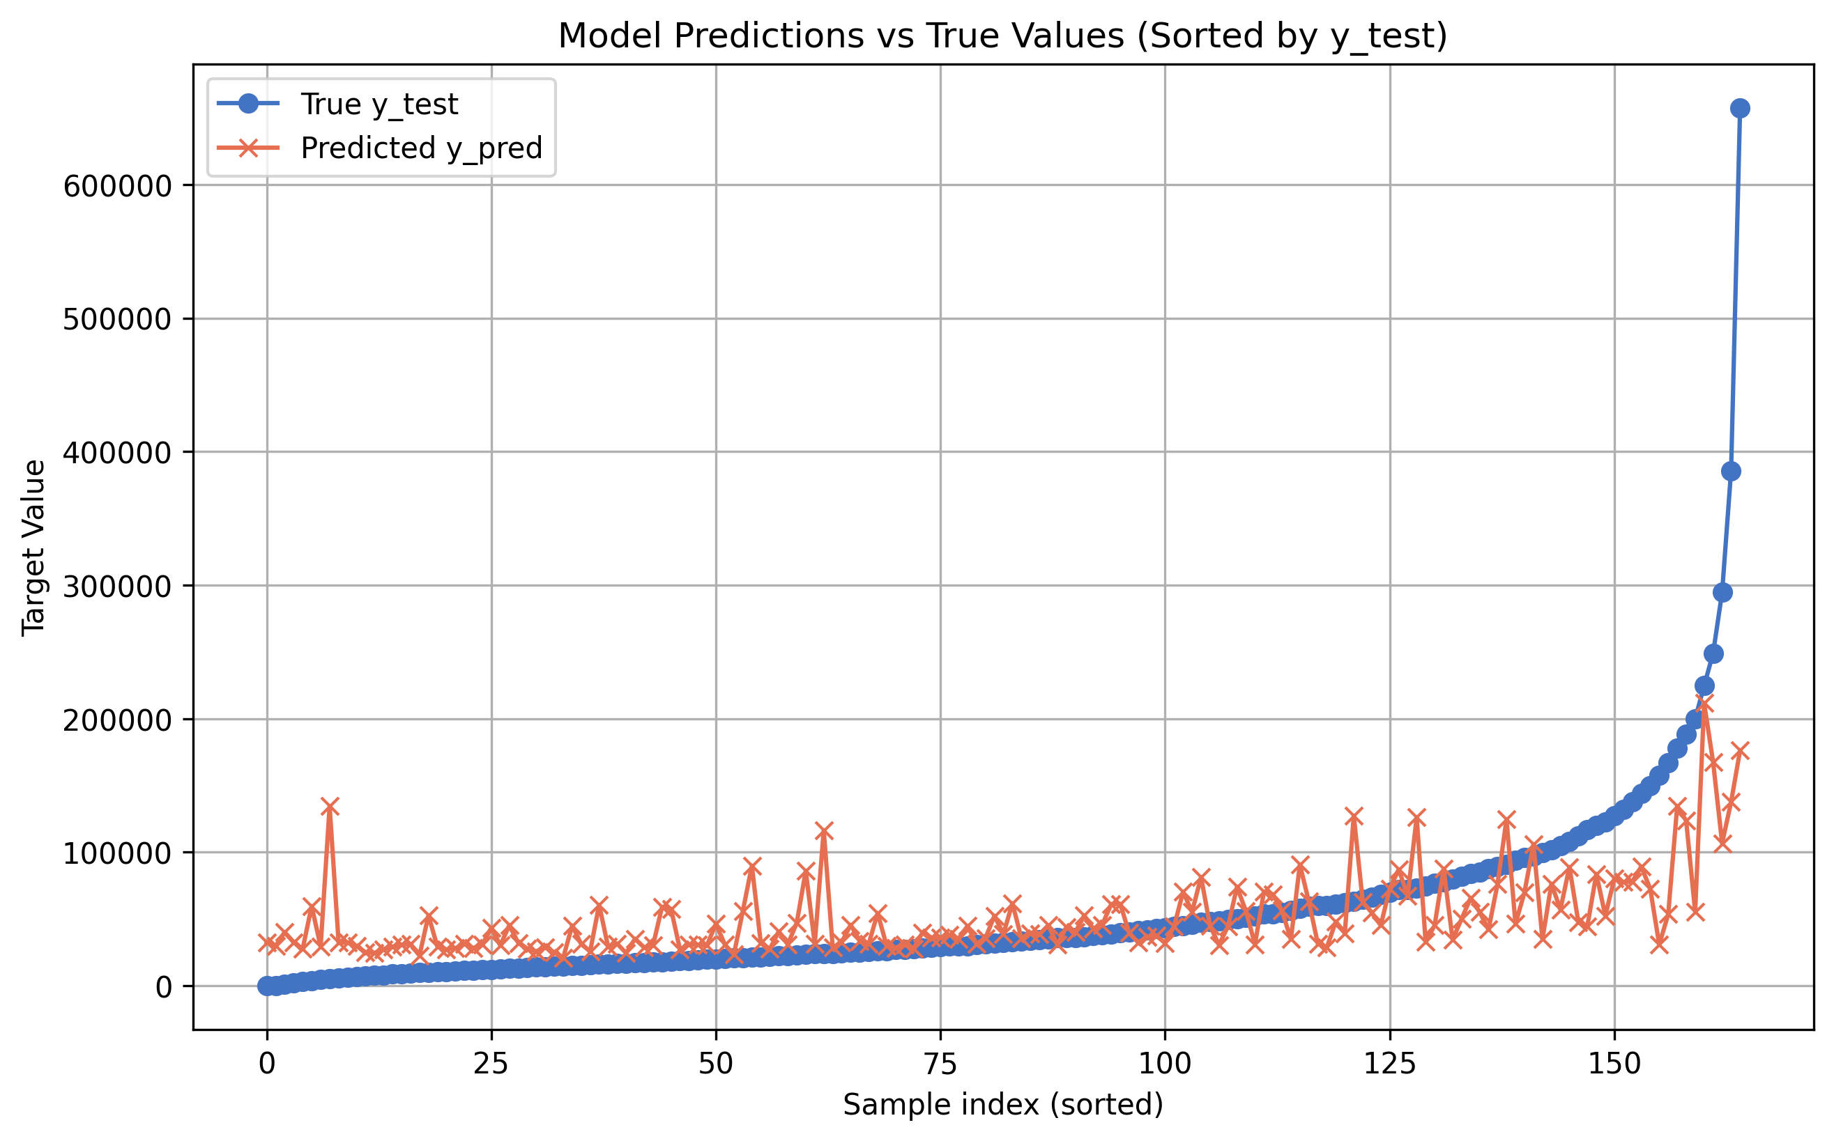
Predictions

Slide 38
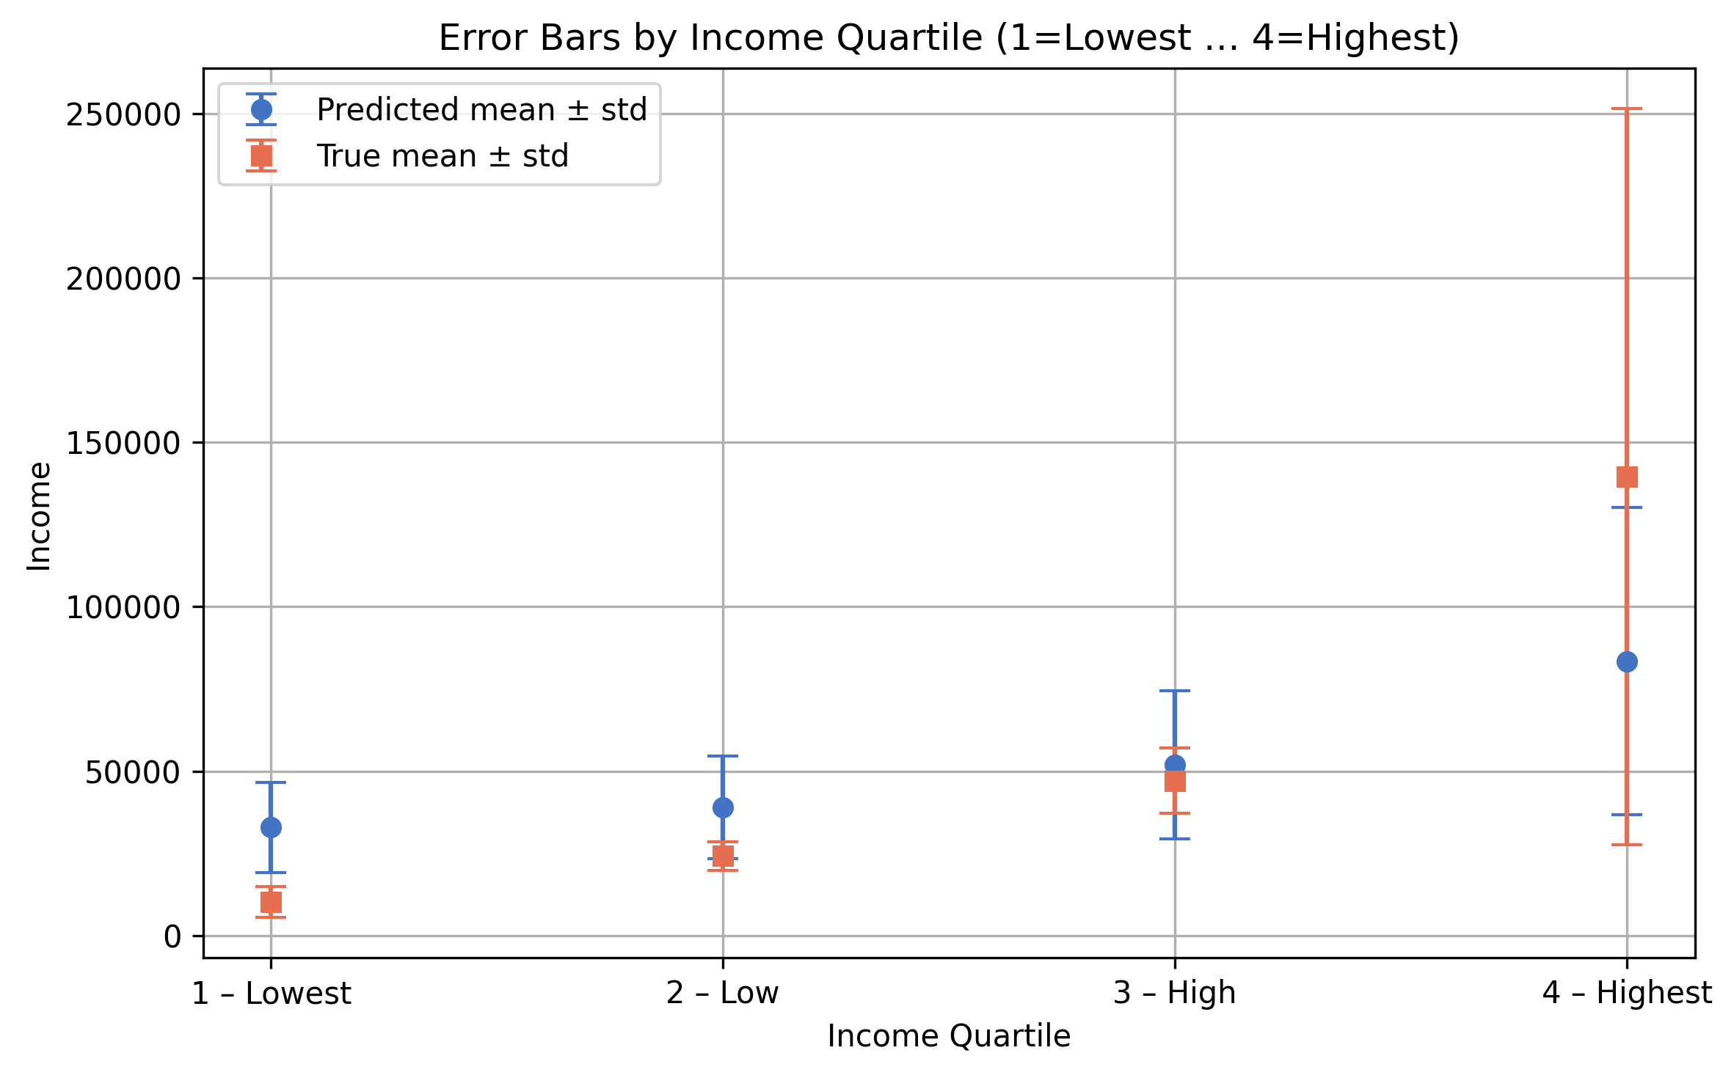
Accuracy

Slide 39
Accuracy (cont.)
R2 Score | Skewness | Kurtosis
0.309 | 2 | 26
Metric | Loss | Conversion | Loss
L1 Loss MAE | 29’397 Rupee | 0,0098 | 287 CHF
1 – Lowest | 22’659 Rupee | “ | 222 CHF
2 – Low | 15’028 Rupee | “ | 147 CHF
3 – High | 15’685 Rupee | “ | 153 CHF
4 – Highest | 64’234 Rupee | “ | 629 CHF

Slide 40
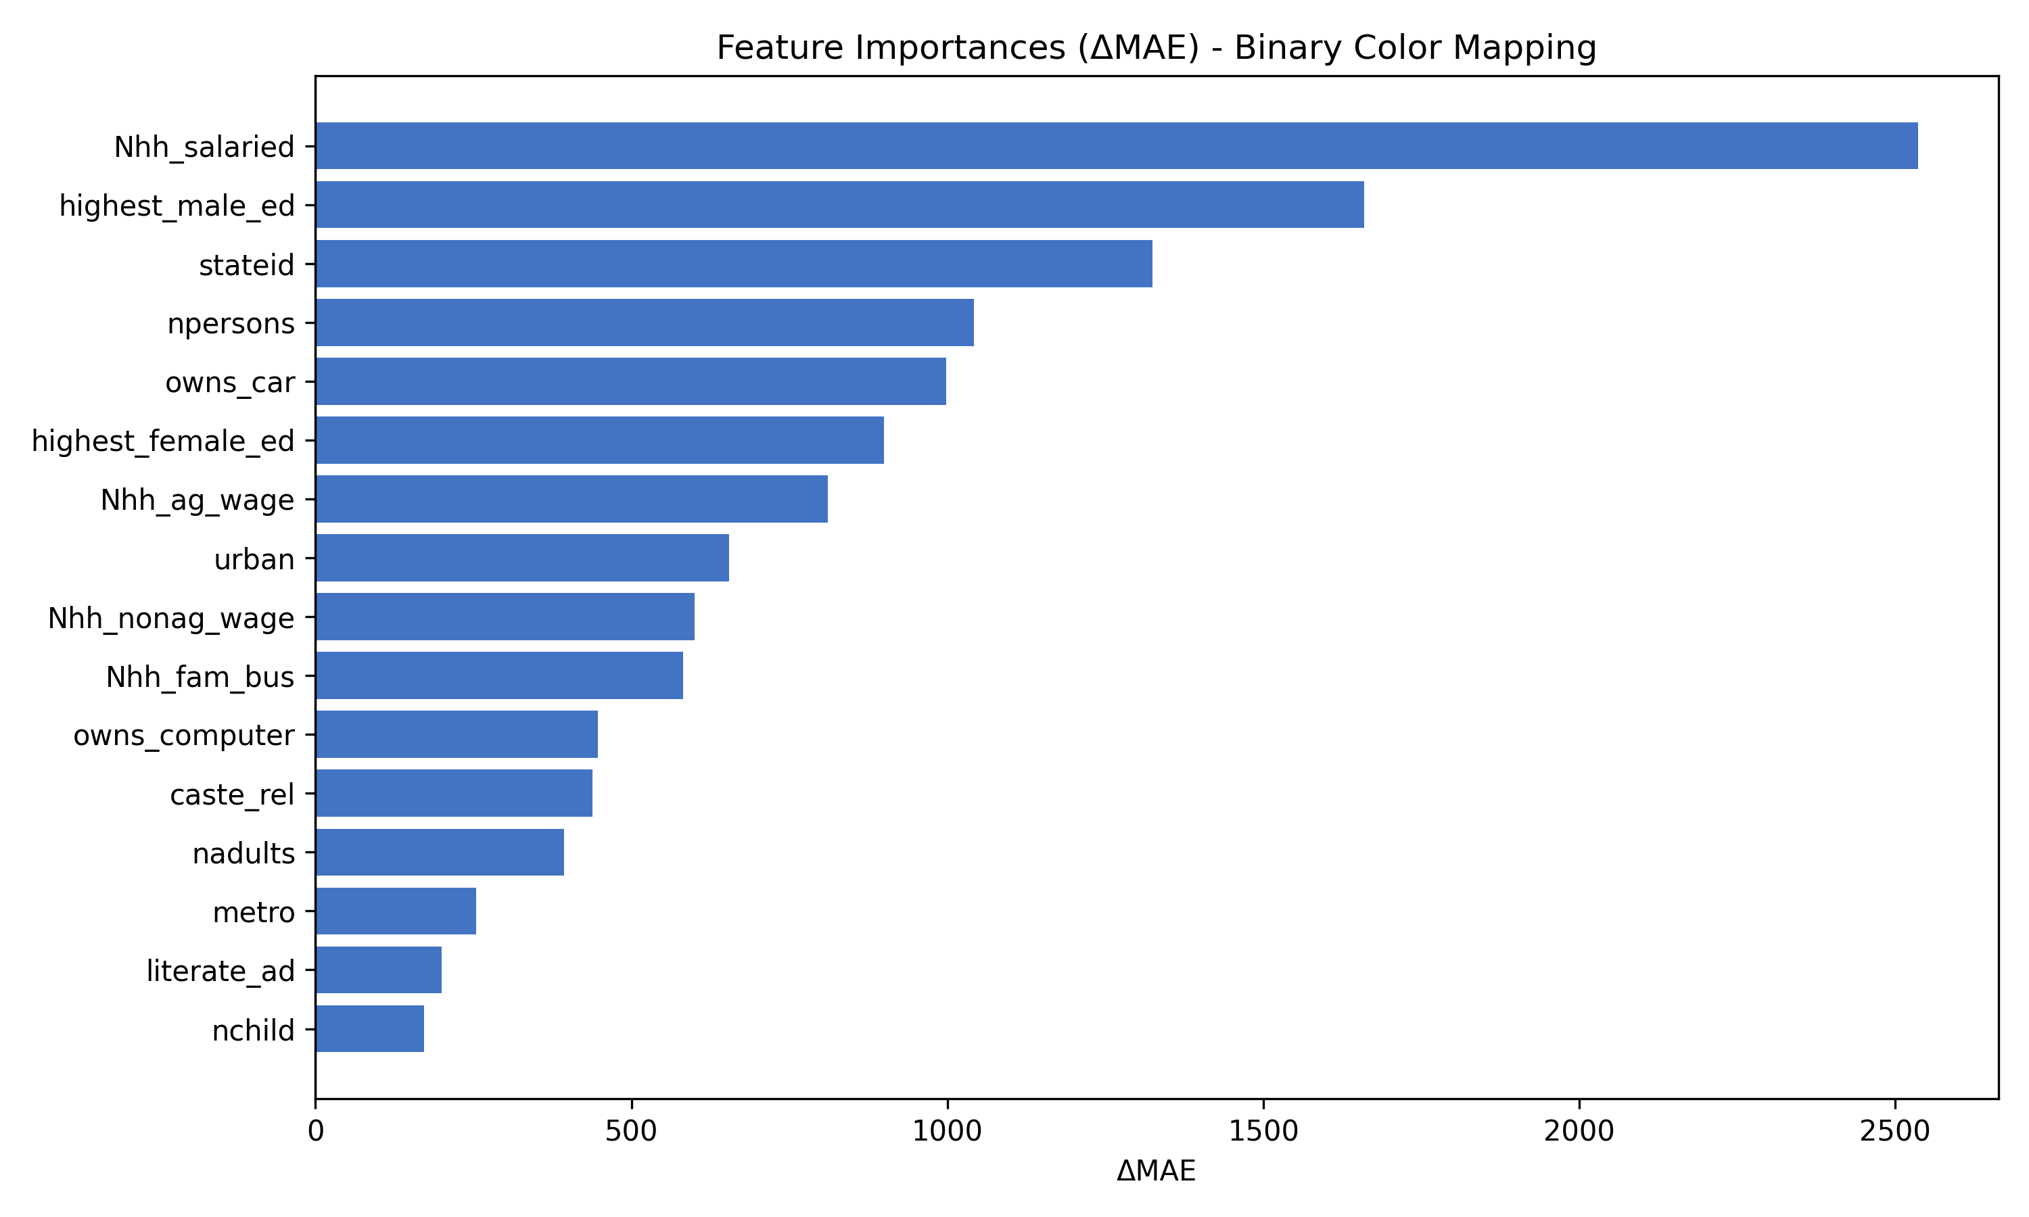
Sensitivity Analysis

Slide 41
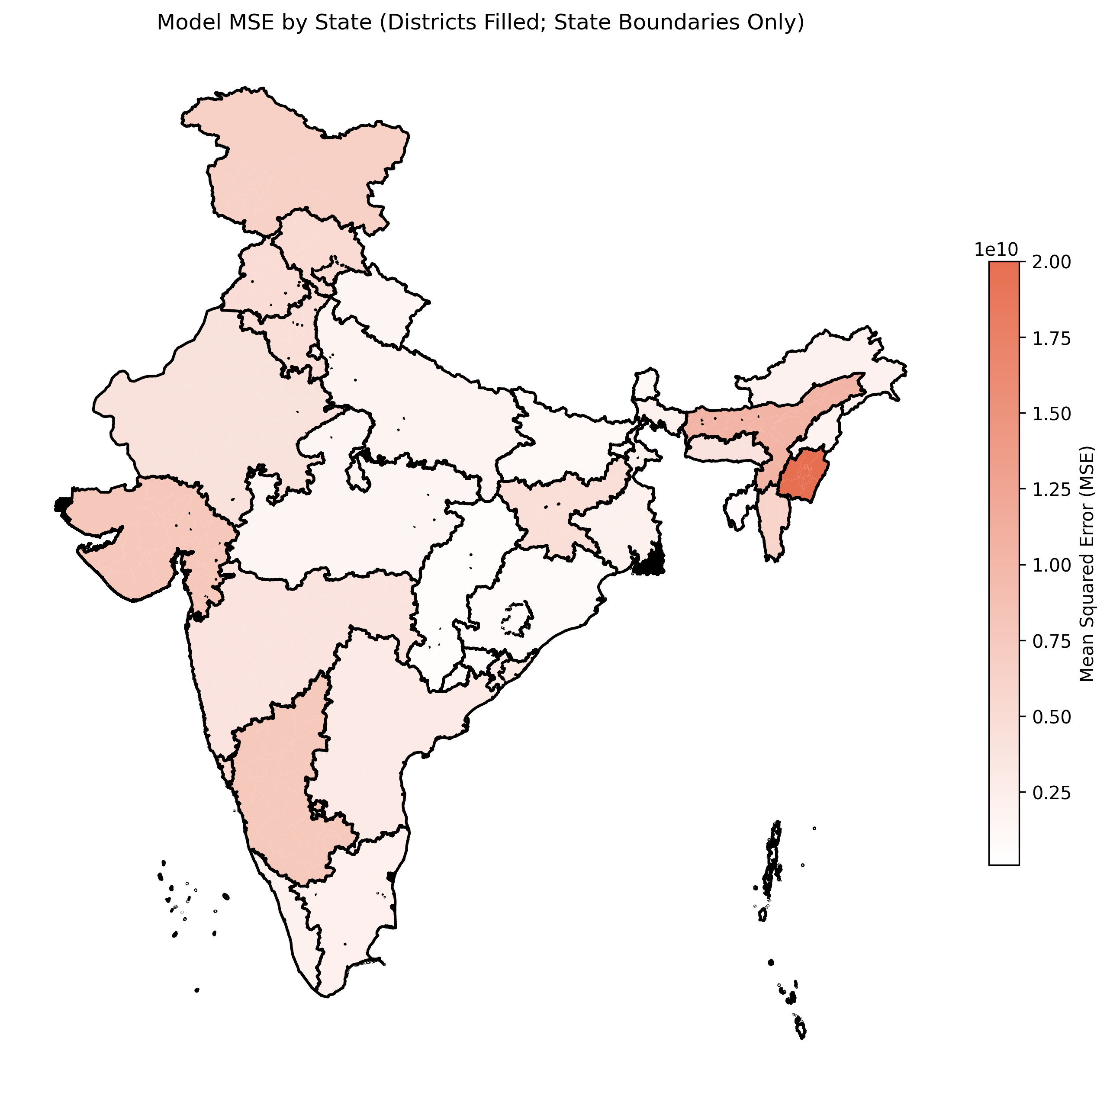
Bias and Fairness

Slide 42
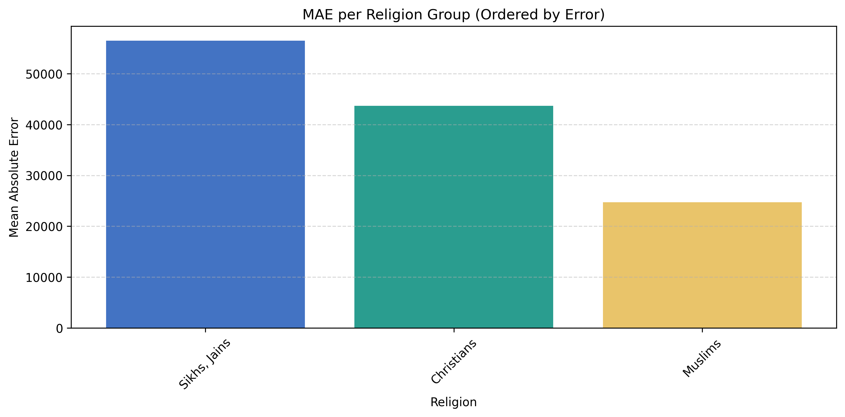
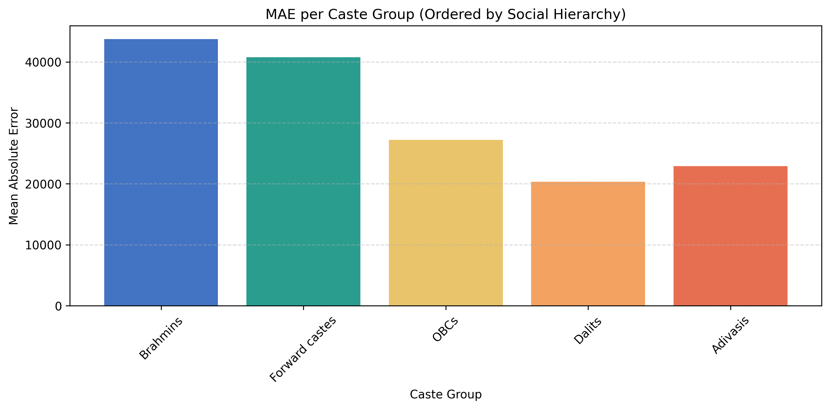
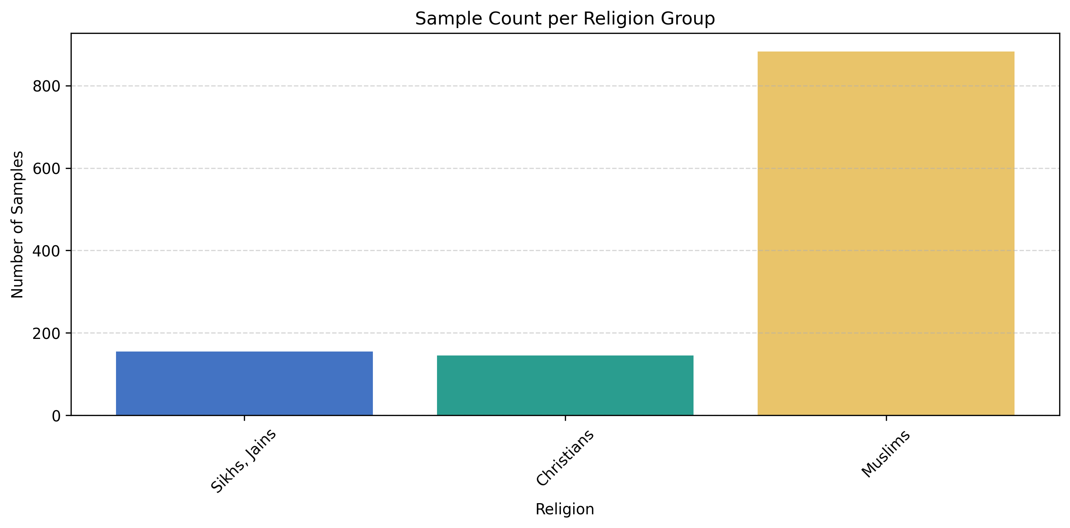
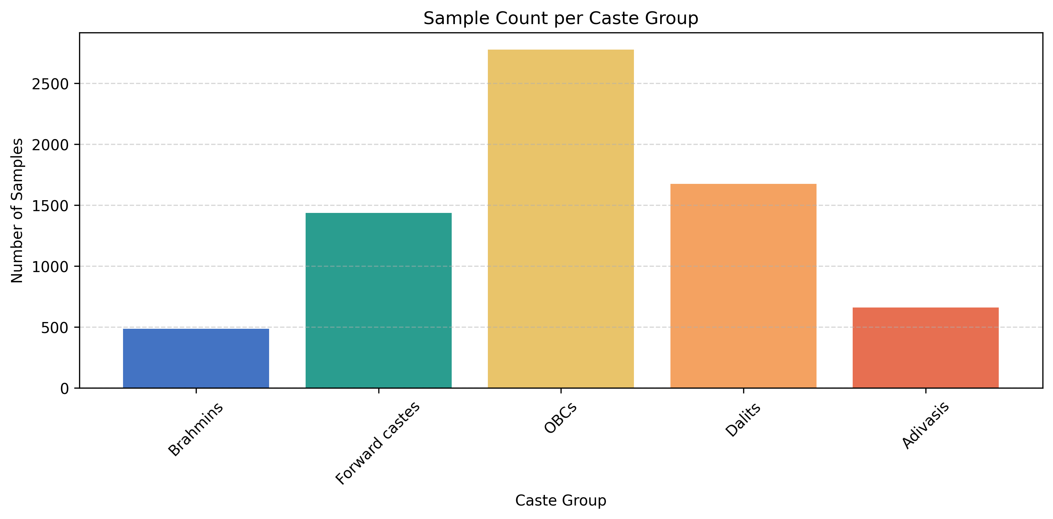
Bias and Fairness (cont.)

Slide 43
Conclusion
Thoughts
Improvements
Neural network captures non-linear relationships in the data that simple linear regression misses
Highest male education emerged as one of the mst influential features, indicating strong correlation between education and household income.
Fairness concerns: Model performance varies significantly across caste an religion groups. (Bias or data imbalance)
Model struggles with extremes or outliers: as observed in the residual analysis
Focus on HH with <= 200’000 Rupee income Try to improve model calibration and consider training a separate model for both segments.
Temporal information
External data enrichment
Feature engineering
Notes:
Temporal information other datasets as IHDS 2 and 3
External data enrichment: incorporating regional variables
New features such as dependency rations, interaction terms (education * caste)

Slide 44
Summary
Performance: R²
Conclusion
US (aggregate) | Germany (aggregate) | US (individuals) | India (individuals)
~0.9 | ~0.7 | ~0.3 | ~0.3
Aggregate income data are easier to predict than the income of individuals using socioeconomic factors (incl. education)
Individuals exhibit more variance for similar backgrounds
More factors are needed to know individual behaviour and environment important for predicition
→ Higher number of samples and features are needed, but unrealistic to receive such detailed and extensive datasets

Slide 45
Future Work
Improvements
Additional Analysis
Feature engineering
Compare prediction of more ML model
Comparisons intercontinental: Use the same features and similar ML Models across countries to better assess the difference in feature importance across regions. e.g. predict income in USA for individual living in India
Agent-based modelling to better understand interaction between individuals and explore emergent behaviour

Slide 46
Reference/ Literature/ Further Reading
Sources
Link
ACS: 5-Year Estimates Data Profiles
Tiger: Shapefile
Regionaldatenbank Deutschland
Geobasis DE VG250 (Shapefile)
IPUMS US, custom dataset
IHDS
Shapefile (Github)
Github
https://data.census.gov/table?d=ACS+5-Year+Estimates+Data+Profiles
https://www2.census.gov/geo/tiger/
https://www.regionalstatistik.de/genesis/online
https://gdz.bkg.bund.de/index.php/default/digitale-geodaten/verwaltungsgebiete/verwaltungsgebiete-1-250-000-stand-01-01-vg250-01-01.html
https://www.icpsr.umich.edu/web/DSDR/studies/22626
IPUMS USA
https://github.com/simon-0006/Data-Science-GESS---Group-Project/tree/main

Slide 47
Questions?

Slide 48
Declaration of Originality
We hereby declare that this work is the result of our own original effort and has not been submitted, either in whole or in part, for academic credit at any other institution. All sources of information used in this work have been properly acknowledged, and all quotations are clearly indicated.
We affirm that each of us contributed to the work and are collectively responsible for its content. We understand the academic integrity policies of ETHZ and acknowledge the consequences of plagiarism or misrepresentation.

Slide 49
Contributions of Team Members
Content
Name
Country: US, Level: County
Country: Germany, Level: County
Country: India, Level: Household
Country: US, Level: Individual
Pascal Gisiger
Erisa Ismaili
Simon Ganter
Baban Deep Virk

Slide 50
Backup Slides- Germany

Slide 51
Possible Features
Minimum income support benefits
Employed Residents
Employed persons (at place of work)
Schools (1995)
Unemployed Residents
Target:
Mean Household INcome

Slide 52
Possible Features
Minimum income support benefits
Employed Residents
With an academic degree
With recognized vocational degree
Without vocational degree
(total and foreign)
Total standard benefit under SGB I (employable and non-employable)
Assistance for living expenses
Old age and disability
Asylum Seekers Benefit
Employed persons (at place of work)
Schools (1995)
Agriculture
Industry
Manufacturing
Construction
Trade & Transport
Finance & Real Estate
Public & Social Services
Gymnasien
Hauptschulen
Realschulen
Integrierte Gesamtschulen
Sonderschulen / Förderschulen
Schularten mit mehreren Bildungsgängen
Unemployed Residents
15-20 years
15-25 years
55-65 years
Foreign
Disabled
Longterm
Target:
Mean Household INcome

Slide 53
Possible Features
Normalize by 15-65 years population within a Regional Unit
Minimum income support benefits
Employed Residents
With an academic degree
With recognized vocational degree
Without vocational degree
(total and foreign)
Total standard benefit under SGB I (employable and non-employable)
Assistance for living expenses
Old age and disability
Asylum Seekers Benefit
Employed persons (at place of work)
Schools (1995)
Agriculture
Industry
Manufacturing
Construction
Trade & Transport
Finance & Real Estate
Public & Social Services
Gymnasien
Hauptschulen
Realschulen
Integrierte Gesamtschulen
Sonderschulen / Förderschulen
Schularten mit mehreren Bildungsgängen
Unemployed Residents
15-20 years
15-25 years
55-65 years
Foreign
Disabled
Longterm
Target:
Mean Household INcome

Slide 54
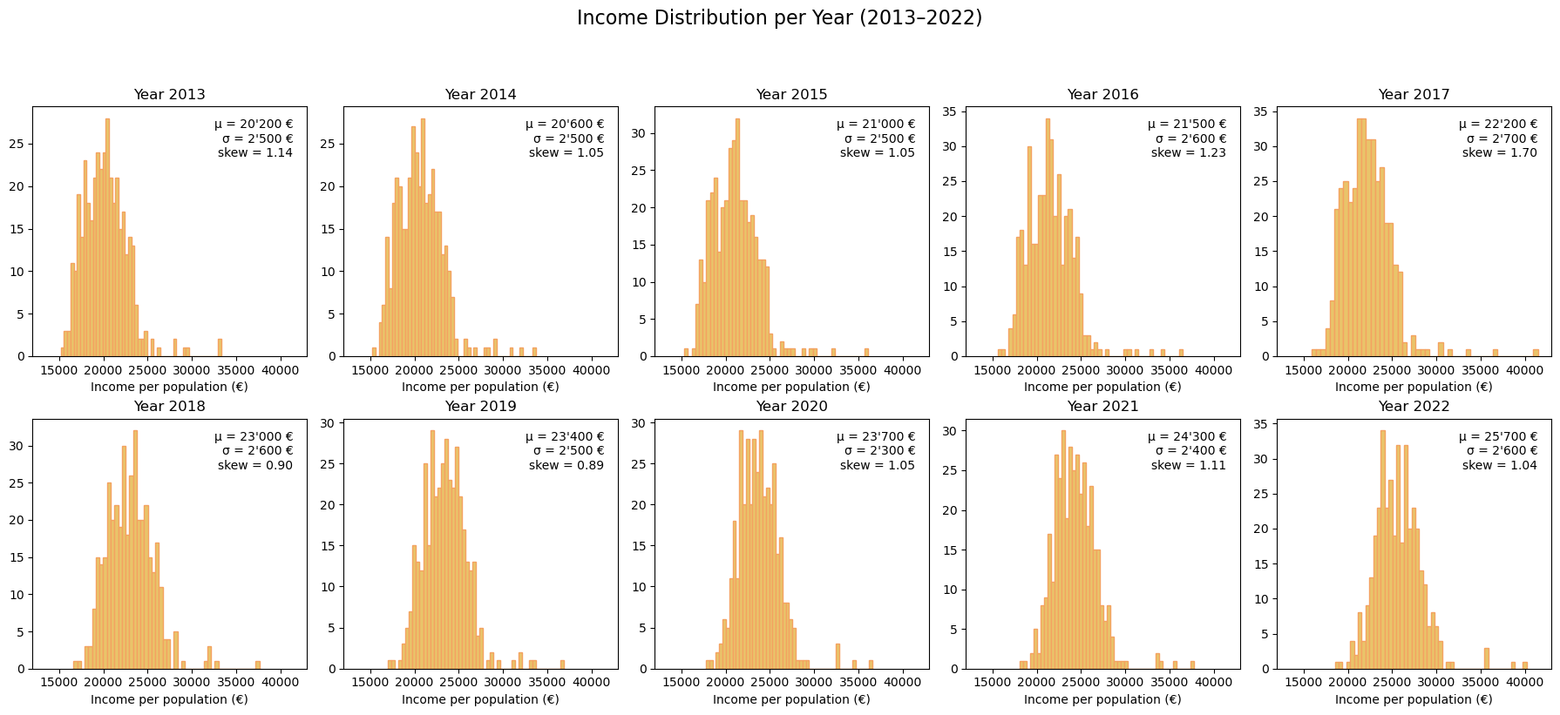
Income distribution

Slide 55


Income distribution (adjusted)

Slide 56
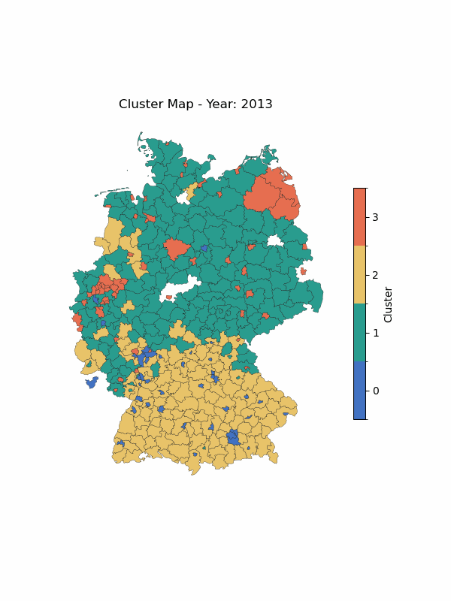
Clustering

Slide 57
Backup Slides- US (individual)

Slide 58
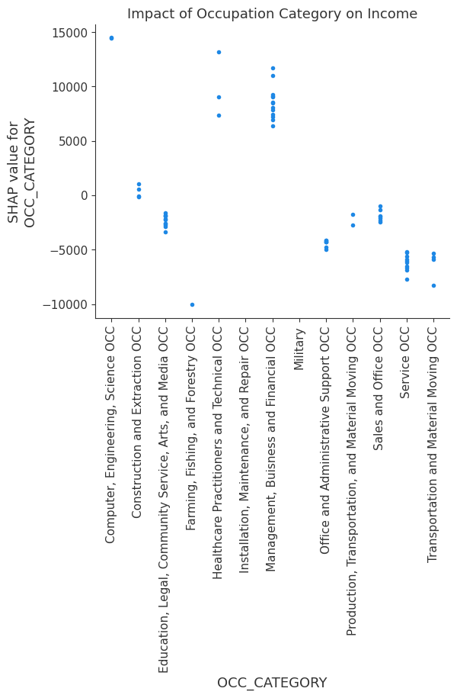
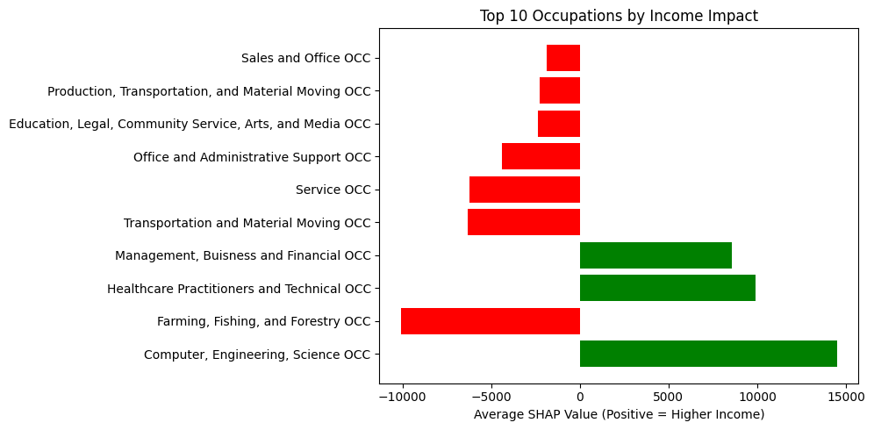
INCOME BY OCC

Slide 59

INCOME BY STATE

Slide 60


CHILD/PARENT EDUC

Slide 61


CHILD/PARENT EDUC

